Slide 1
IBM CLOUD IAM
Secure access for cloud object storage(COS)
Name: Harsh Mishra
Course: BCA 1st year

Slide 2
What is COS
💻 In IBM Cloud context:
1) COS stands for Cloud Object Storage.
It’s a service by IBM that allows you to store, retrieve, and manage files (objects) in the cloud.
2) Used for secure, scalable file storage like images, videos, backups, logs, etc.
3) Works with APIs and SDKs (like Python, Java, etc.) for uploading/downloading files.
🔒 You might also hear it used with IAM (Identity and Access Management) — for setting permissions on who can access your COS files.

Slide 3
What is IAM
IAM (Identity and Access Management) is a framework of policies and technologies used to verify user identities and control their access to resources in an organization or cloud platform.
✅ Main Functions of IAM:
Authentication→ Verifying who the user is (e.g., through username/password, OTP, biometrics).
Authorization→ Deciding what the user is allowed to do (e.g., read-only access, or full admin access).
Access Policies→ Defining rules for access control (e.g., only team leads can delete files).
Monitoring & Auditing→ Keeping logs of who accessed what, and when.

Slide 4
Objective
To securely upload, store, and retrieve files on the cloud using IBM Cloud Object Storage with IAM authentication and Python.
Technologies Used
IBM Cloud
IBM COS (Cloud Object Storage)
IBM IAM (Identity & Access Management)
Python (with ibm_boto3)
Visual Studio Code (VS Code)
Steps Followed
Created a COS bucket on IBM Cloud
Generated API key and Service Instance ID
Wrote Python script to:
Upload file to COS
Download file from COS
Verified file storage via IBM Cloud Console

Slide 5
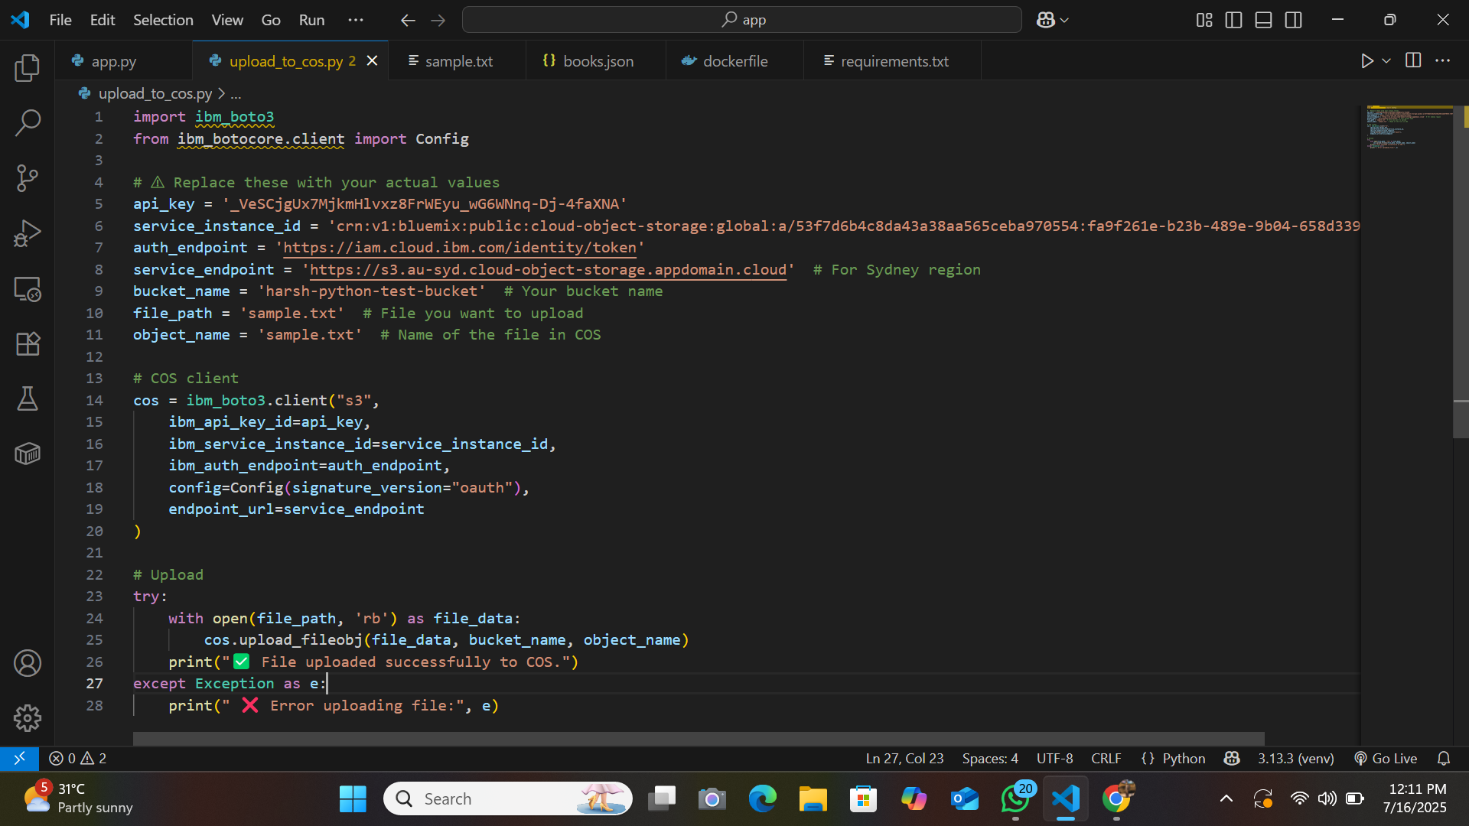
Upload Script (Python)

Slide 6
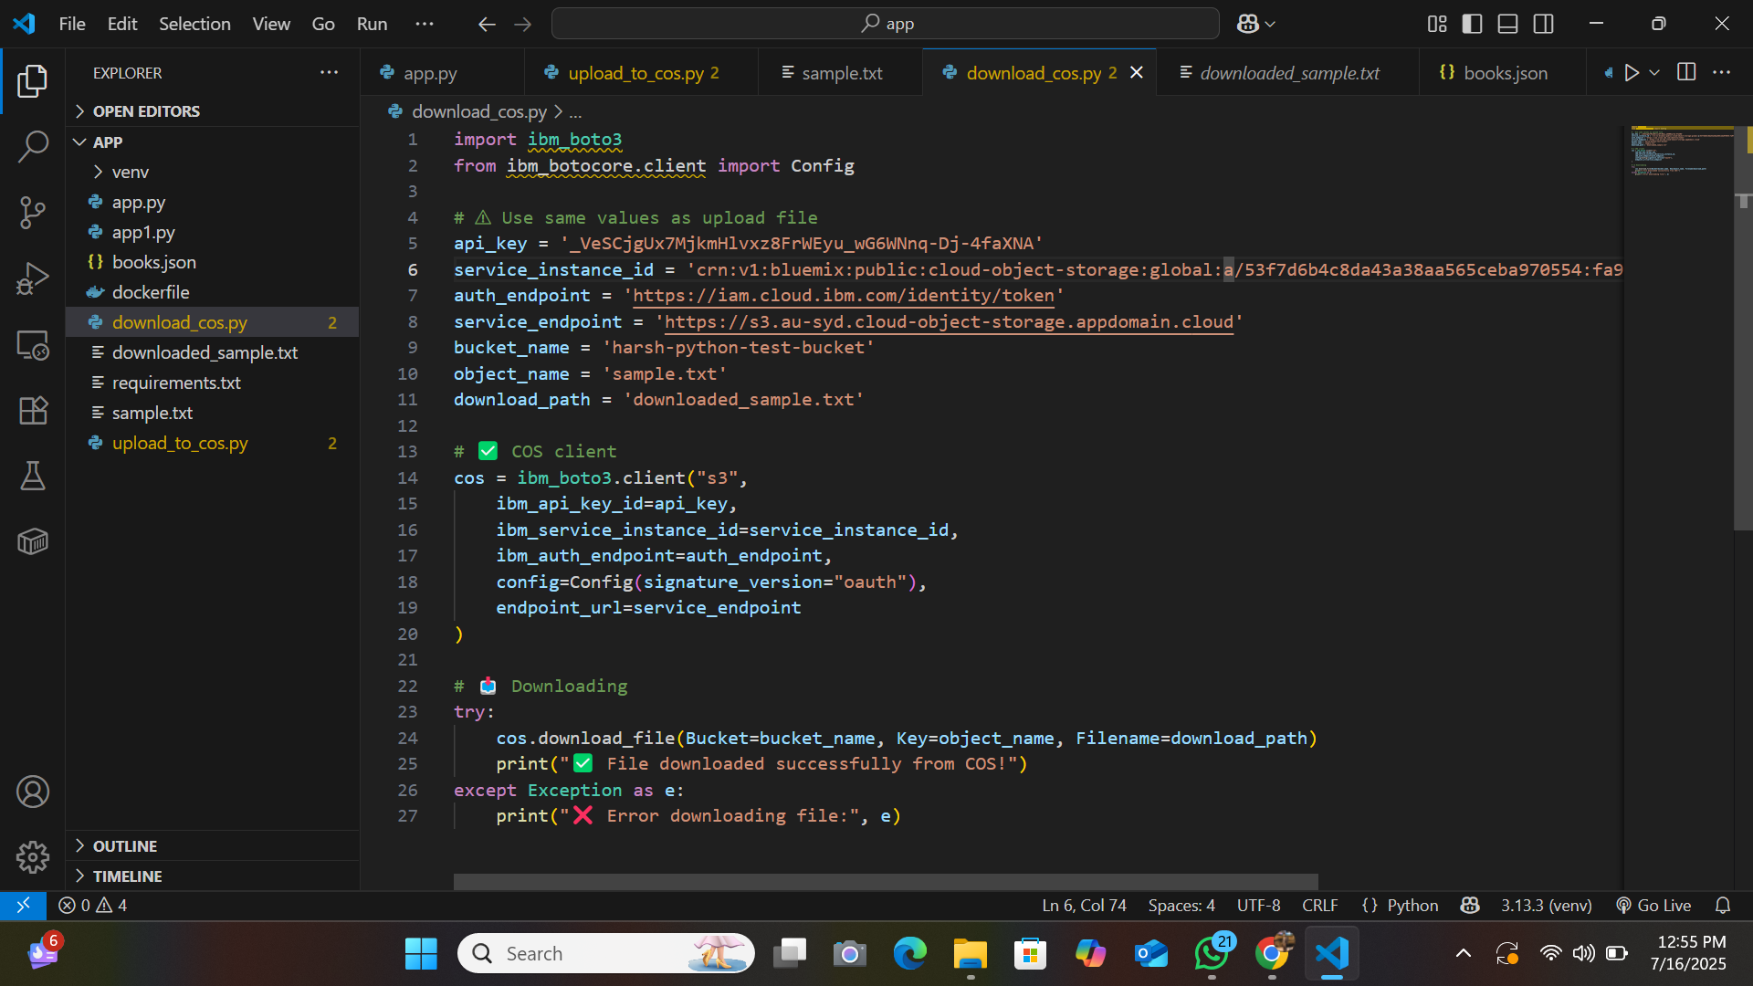
Download Script (Python)

Slide 7
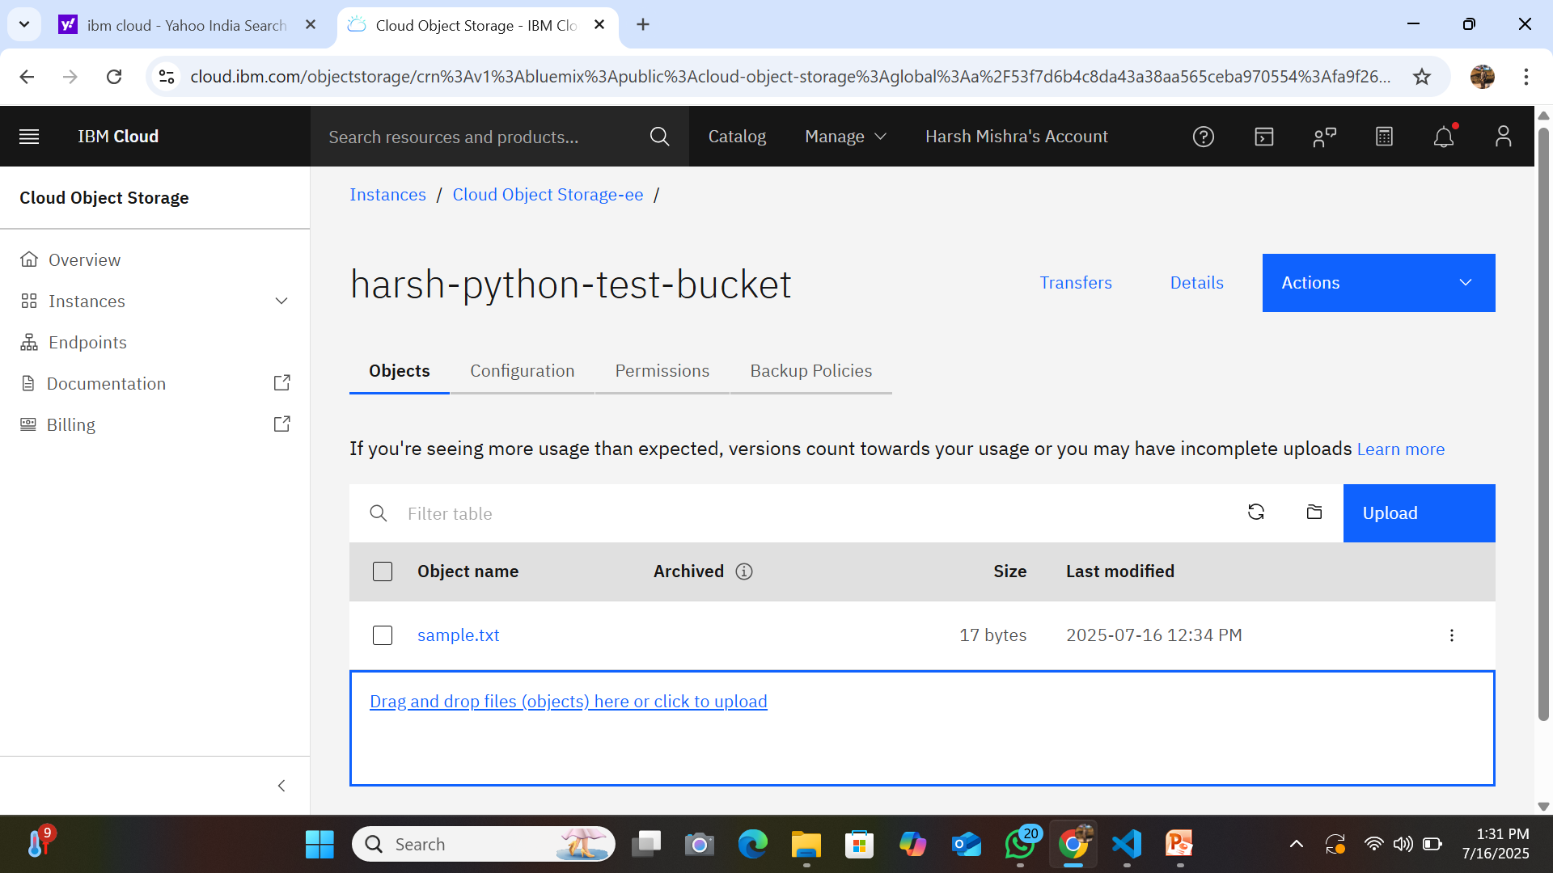
IBM Cloud Console
Screenshot of the bucket showing uploaded sample.txt file

Slide 8
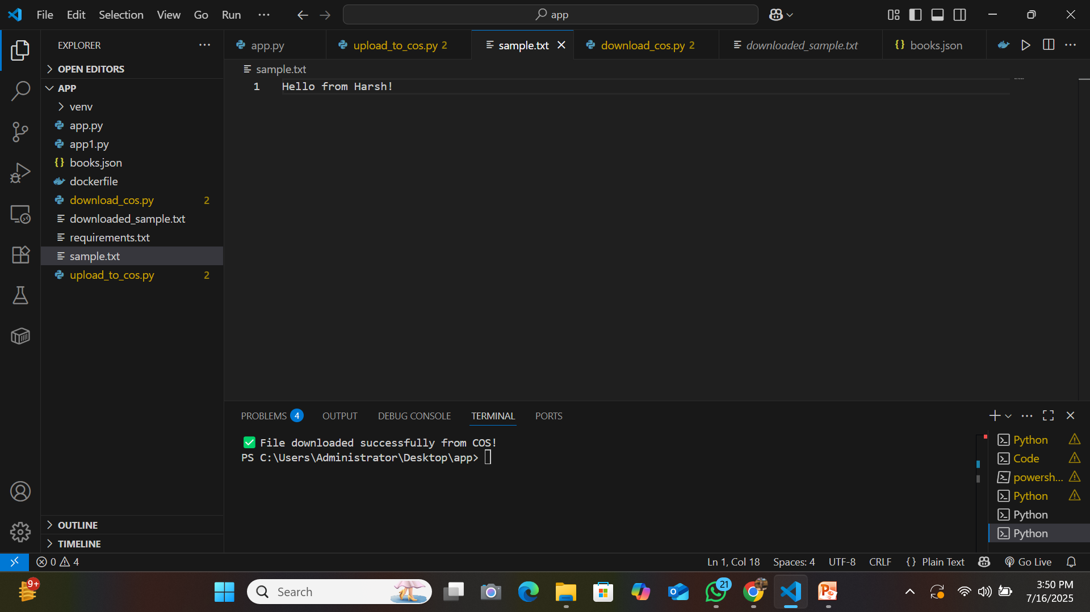
Output
File uploaded: sample.txt

Slide 9
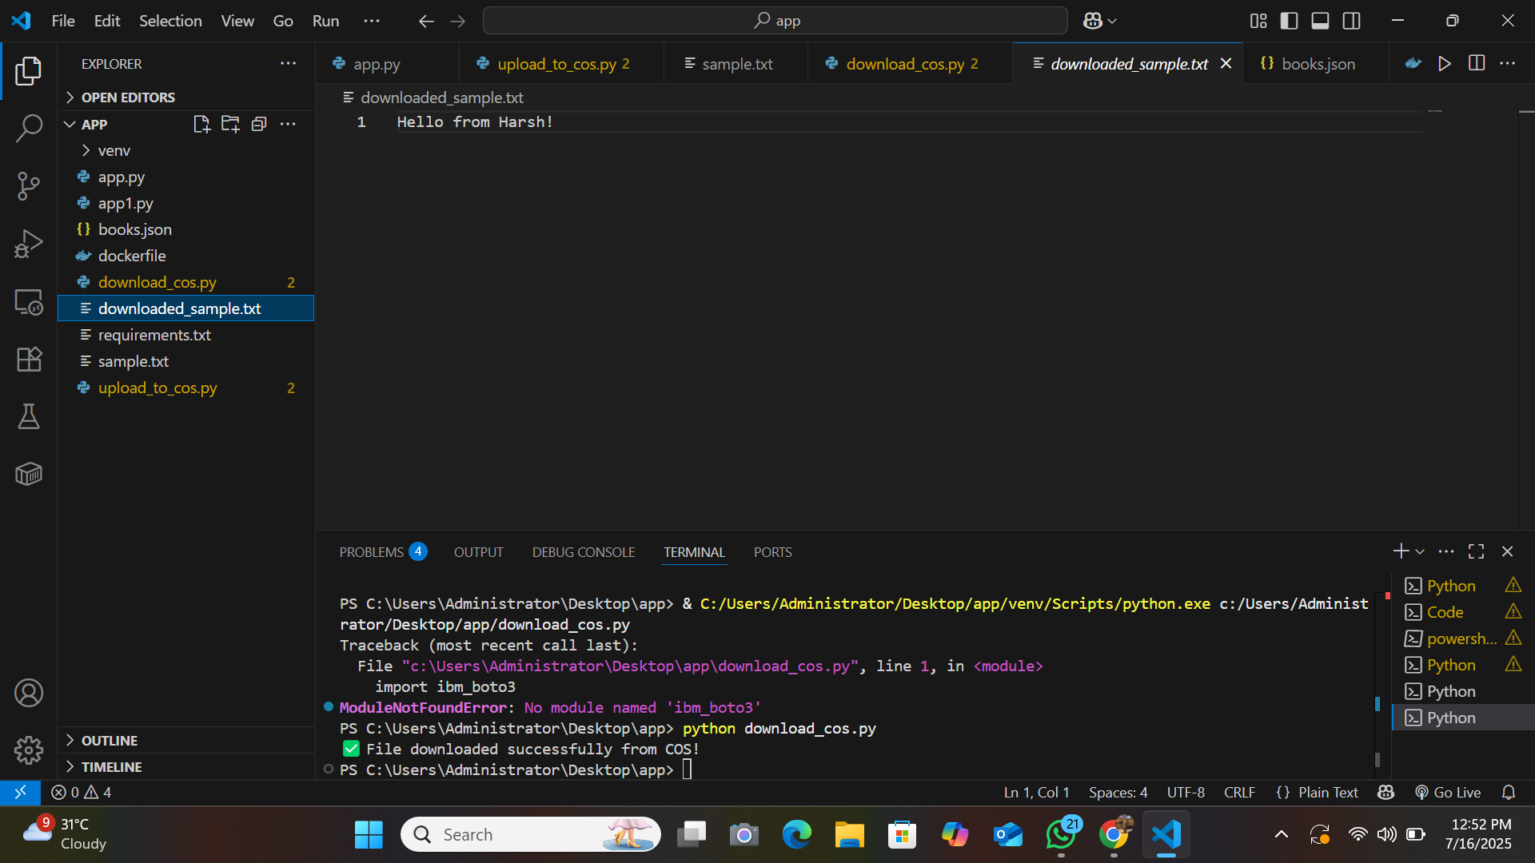
File downloaded: downloaded_sample.txt
File content successfully matched

Slide 10
Security
API key securely used in code
IAM authentication for access control
Private bucket (accessible only by authenticated users)
Conclusion
IBM COS provides a reliable and secure way to manage cloud file storage. With Python integration, automation becomes easy and scalable.

Slide 11
Thank you sir

